Slide 1
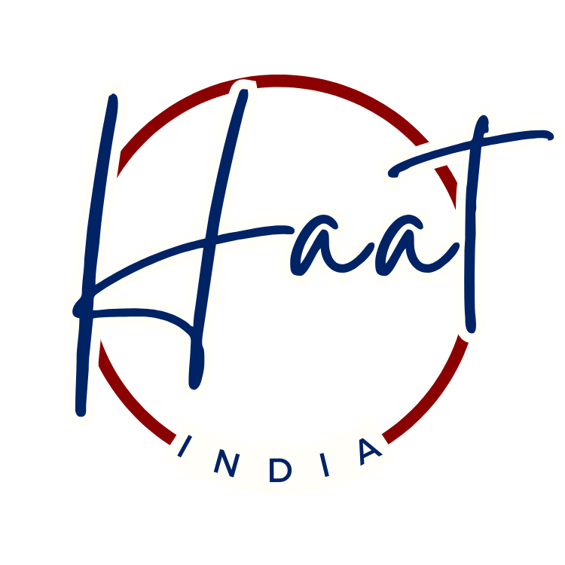
Brand Guideline
Crafted from tradition, trusted by you.

Slide 2
Introducing Haat India
What is the purpose of Haat India?
We connect the world with authentic, regionally crafted traditional products through an innovative omnichannel retail experience
We’re digitizing the traditional ‘Haat’ into a trusted one-stop destination, offering authenticity, quality, and affordability to meet the needs of the modern shopper
We offer a thoughtfully curated selection of unique regional products that highlight India's cultural and artisan traditions
We deliver premium, authentic products made by talented artisans, directly from their origin, at affordable prices—no expensive brand premiums
Our technology-enabled, robust supply chain ensures product authenticity, sourcing transparency, and exceptional customer service
Haat India’s mission is to revolutionize the traditional "Haat" concept by modernizing the retail experience through technology and a robust supply chain, delivering authentic, high-quality, regionally produced, and globally recognized Indian traditional products. By celebrating and preserving India’s rich cultural heritage and artisan craftsmanship, we connect these popular products to global markets through an innovative omnichannel strategy. We are committed to offering a curated selection of authentic products at affordable prices, eliminating the hefty costs associated with brand names. Our mission is to ensure product authenticity and deliver exceptional customer experiences, building a trusted brand rooted in tradition and quality.
Our vision is to establish Haat India as the leading omnichannel retail company for India’s most popular and authentic traditional products, known globally for our unwavering commitment to quality, affordability, and customer satisfaction. We envision a future where every customer can effortlessly access a diverse range of regionally celebrated traditional Indian products, enriching their lives while supporting sustainable practices and fostering a deep appreciation for India’s cultural heritage and craftsmanship. Through our innovative approach and dedication to excellence, Haat India aims to become a trusted symbol of authenticity and value in the global retail landscape.
Mission
Vision

Slide 3




Logos
Option 1- Final
Option 2
White Background
Transparent Background

Slide 4
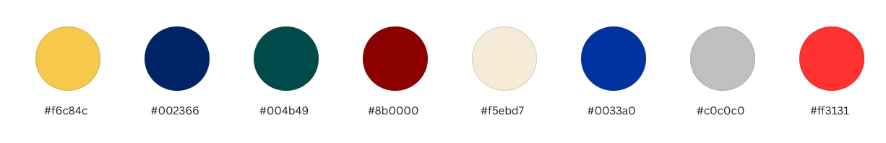
Color Pallet and Typography
Optional Color
Primary Color
Optional Color
Primary Color
Secondary Color
Optional Color
Secondary Color
Optional Color
Segment | Font Type | Font Size
Heading | Playfair Display – Semi bold | 24
Subheading | Playfair Display – Semi bold | 16
Section Header | Playfair Display – Semi bold | 16
Body | Playfair Display – Regular | 12
Quote | Playfair Display – Regular Italic | 12
Caption | Playfair Display – Regular | 12

